Slide 1
Azure Data Factory Capstone –
Covid Use Case
By
Hema Dharani Tummalapalli (2320074)

Slide 2
CONTENTS
Objectives
Requirements
Architecture diagram
Pipeline structure
Pipelines and dataflow
Outputs
Data Verification
I
Portfolio Build Up
Areas Of Focus
Summary

Slide 3
OBJECTIVES
Build a real-world data pipeline in Azure Data Factory (ADF) to analyze the covid trend across the regions using Azure cloud data services.​
Ingest data from flat files into Azure Data Lake Gen2 and Azure Synapse using Azure Data Factory (ADF) ​
Transform data using Data Flows in Azure Data Factory (ADF) .

Slide 4
REQUIR EMENTS
The two requirements of the project are
To copy data from azure data lake to synapse analytics using Azure Data Factory
To transform the cases and deaths data using Azure Data Factory
Resources created –Azure Data Lake gen2,Azure Synapse Analytics and
Azure Data Factory
(Currently using free student subscription available on Azure as IIHT lab credentials gotover)

Slide 5
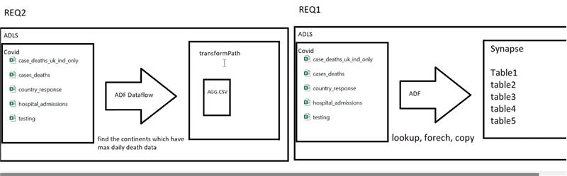
Requirements

Slide 6

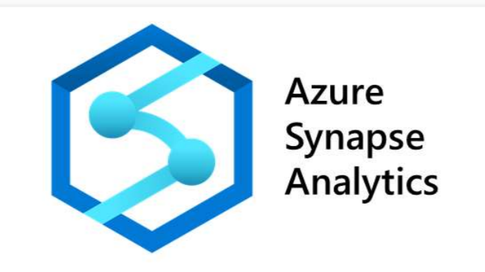


ARCHItecture diagram
SOURCE
Linked service-1
Linked service-2
SINK
AZURE DATA FACTORY
Container:Covid/ingest
Cases and deaths data
Cases and deaths india and uk only
Hospital admissions
Testing
Country response
(CSV)
DATASET-1
DeathsInUKAndIndia
AllOverDeaths
CountryWiseResponseMeasure
HospitalAdmissions
Testing
(TABLE)
DATASET-2
Lookup,foreach,copy activty)
Passing the filename,foldername,SQL table dynamically at runtime using parameters table and storedprocedure

Slide 7
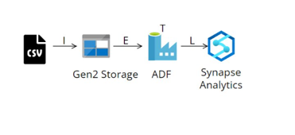
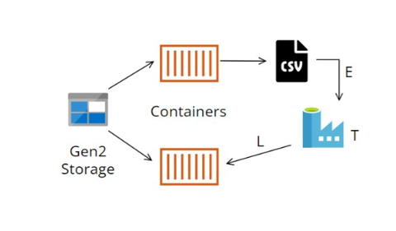

Pipeline-2
Pipeline-1

Slide 8
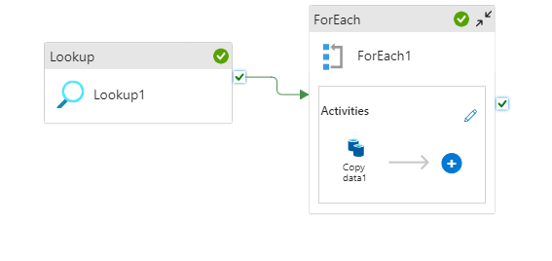
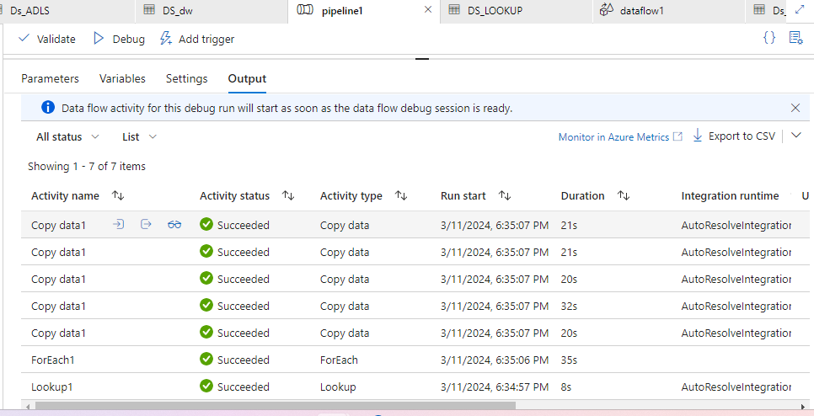
Copy data from azure datalake to synapse

Slide 9
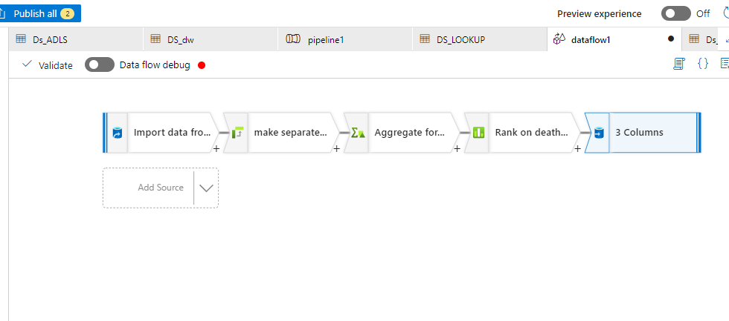
Transformation on data by using Data flow in Data factory

Slide 10
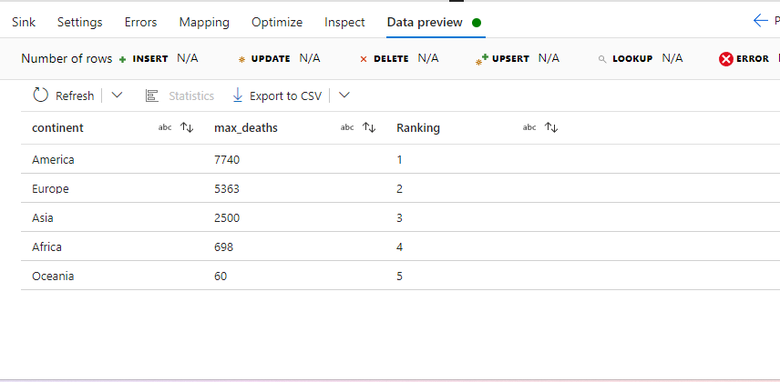
DATA Transformation Output

Slide 11
Data verification
Query-1
Query-2
Write a Query to check the confirmed cases in India in​
March’2020 and verify with source data in excel?​
​
select * from AllOverDeaths​
where [country]='India' and​
[indicator]='confirmed cases' and​
MONTH ([date])='3' and​
YEAR ([date])='2020';
Write a query to show country wise confirmed​
case in 2020?​
select [country],[indicator],[daily_count],[date] from AllOverDeaths​
where [indicator]='confirmed cases' AND​
YEAR ([date])='2020'​
Group by [country],[indicator],[daily_count],[date]​
order by [country] asc,[date] asc;​
​

Slide 12
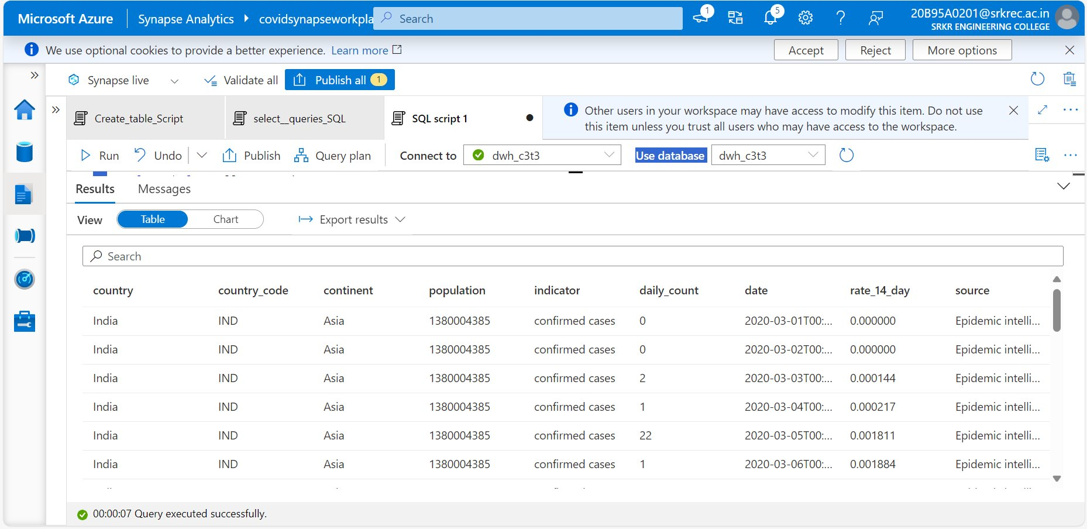
Query 1 output

Slide 13
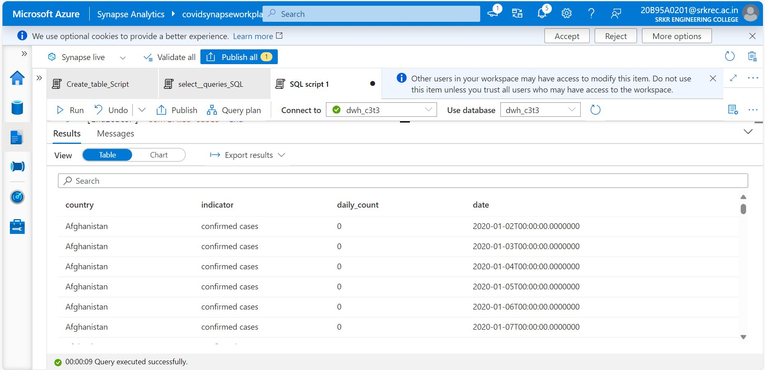
Query 2 output

Slide 14
THANK YOU
Hema Dharani Tummalapalli
2320074@cognizant.com

